Slide 1
The Finnish Cadastre: Fully Digital with Full Coverage, and an Interoperable Part of the Base Register System - but is that Enough?
Vienna, November 20, 2018
Pekka Halme
Director of Strategic Development

Slide 2
contents
Some facts
Short history
Current discussion
Steps towards future

Slide 3
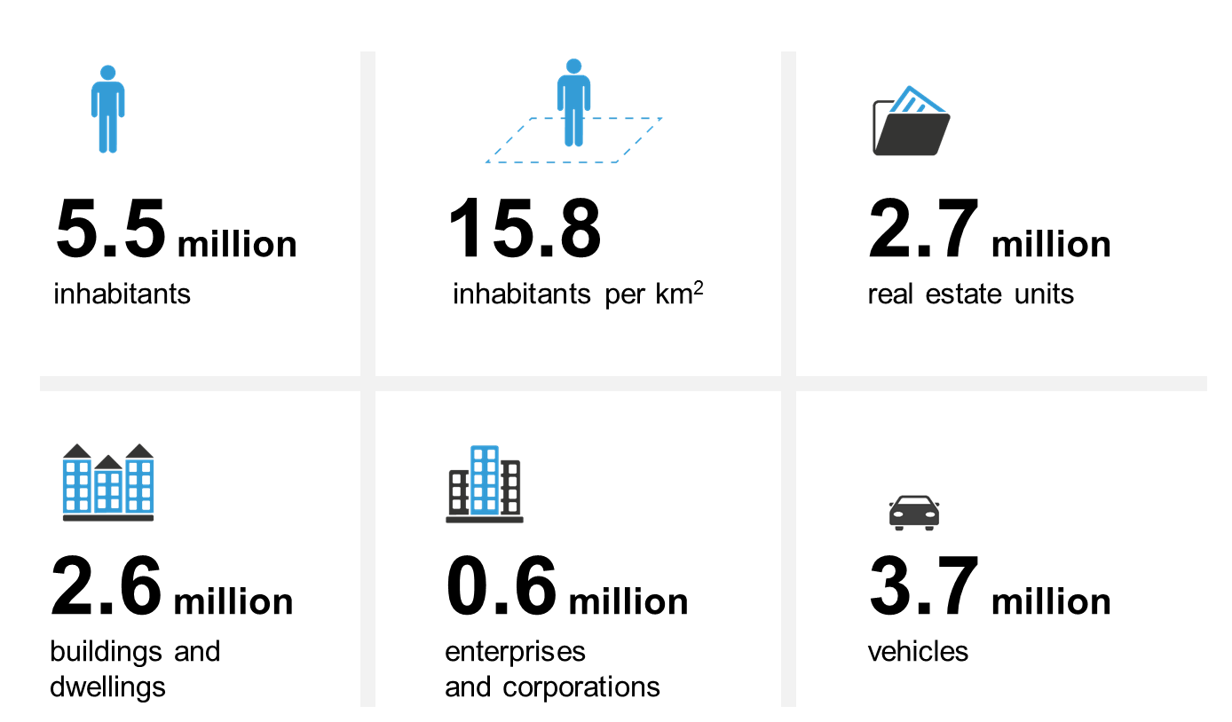
Quick facts about finland

Slide 4
Short history
Roots in the Swedish system
Own Finnish authority 1812
Independence 1917
NLS (11) and municipalities (75) updated their manual Cadastres → 86 primary + national LIS as copy
Land Register in local courts
2005 official nation-wide single Cadastre within LIS
NLS maintain
NLS and municipalities update
Fully digital with full coverage
Land Register to NLS 2010

Slide 5
Dawn of cadastral digitalization
Computerized data processing used first time in a cadastral survey in 1958 (land consolidation).
Computer-based register was introduced in 1970

Slide 6
Cadastre of today
Real Estate Formation Act in 1995 came into force 1997
Same law for urban and rural areas
Earlier partly different rules
Better opportunities to use computerized data processing
New production system JakoKII rolled out 1998
New Land Information System in 2005 →
One nationwide Cadastre and cadastral index map

Slide 7
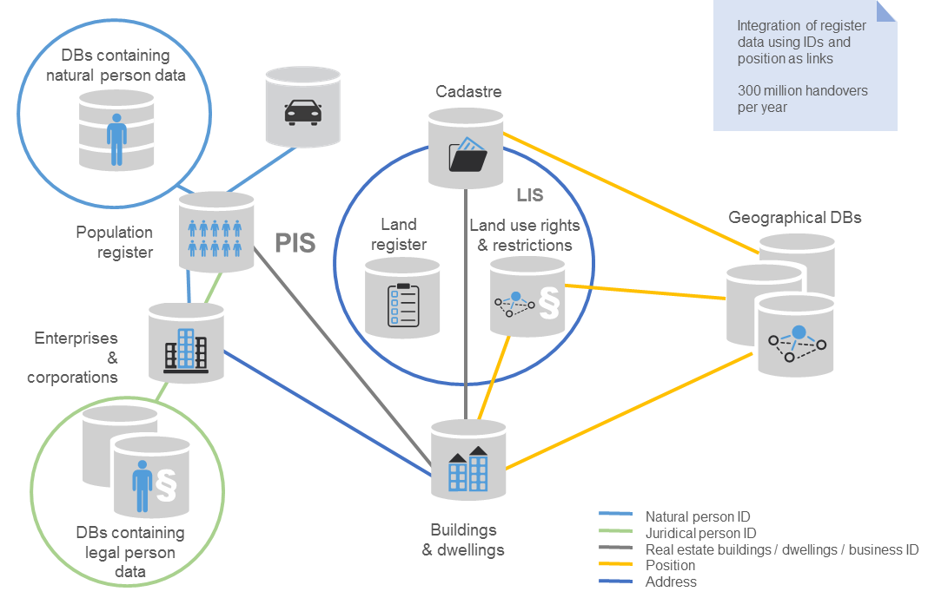
Base register system
Finnish Patent and Registration Office

Slide 8
Content of the Cadastre
Property division
Incl. shares in common areas
Connected rights
Easements, usufructs
Cadastral index map
Register units, their identifiers and boundaries
The State is obliged to pay compensation for errors that are a consequence of decisions taken in cadastral surveys since 1 July 1985.
Part of data has negative and positive faith and credit
The State is obliged to pay compensation for errors in the Cadastre that are the consequence of decisions taken in cadastral surveys since 1 July 1985.

Slide 9
Real property registers
Cadastre
NLS and 75 municipalities update
NLS, maintain
Land Register
NLS, update and maintain
Register on titles and mortgages and special rights
Purchase Price Register
NLS, updating and maintenance

Slide 10
Current issues (1)
Our legacy
Complexity, time layers → varying specifications and data content → data quality improvement projects since decades
What data are relevant for today’s users?
What type of Cadastre do we need in the first place?

Slide 11
Current issues (2)
Our reality
Ongoing change towards digital society overall
Customer needs and demand force towards service orientation
Use of (register) data increases and diversifies
Modern positioning, open data → accuracy of boundary data an issue
E.g. land owners, forest harvesters, infrastructure construction projects…
Is coordinate cadastre a solution? If so, to what problem? What if you just improved the positional accuracy?

Slide 12
Current issues (3)
Technology
Improving internal efficiency
Introduction of automated production processes
Introduction of automated decision making – Land Registry
Not yet AI, legislative and ethical issues
What quality is good enough for the variety of purposes?
Do new technologies like Blockchain play a role?
Crowdsourcing, positioning, sensor data

Slide 13
Current issues (4)
Institutions and organization
Platforms, ecosystems and networks to meet customer needs
Interlinked and interoperable registers and databases
One-stop-shopping
Data quality an essential enabler
Appropriate steering and funding mechanisms

Slide 14
Steps towards our future
Katasteri2035 project
Research study at Aalto University, funded by NLS and MAF
Aim to provide research-based views and scenarios
Ideas and insight for decision making
Internal NLS discussion and studies on the subject
Customer and service based orientation
Activities, organization, and management system revisited
Enterprise architecture approach
3D real properties since Aug 1, 2018 → fundamental change
ASREK project: housing companies and shareholders

Slide 15
The challenge
Legacy
Change
Demands and aspirations

Slide 16
Showing the way

